Slide 1
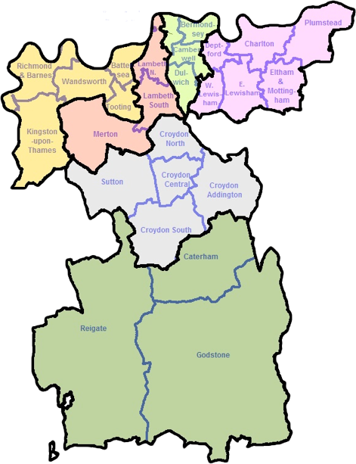
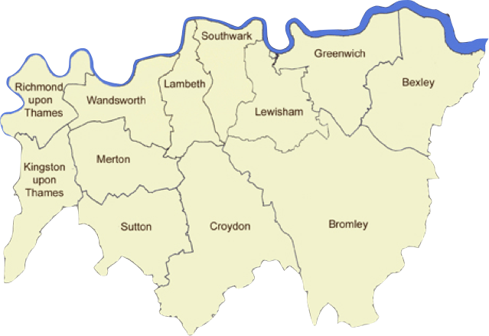



The Diocese
of Southwark
Diocese of Southwark
London Boroughs
south of the Thames

Slide 2
Southwark Diocese
Population of over 2.7 million
823 clergy (353 stipendiary)
474 accredited lay ministers (Readers, SPAs, etc)
357 places of worship (184 listed)
45,000 church members
106 church schools educating 33,000 pupils

Slide 3
Southwark Diocese
25% of the population of the diocese come minority ethnic backgrounds; 35% of congregation members, up from 18% in 2002
9 of the 12 south London boroughs are in the top 50 most religiously diverse authorities
There are more than 60 non-Christian places of worship in the south London boroughs

Slide 4
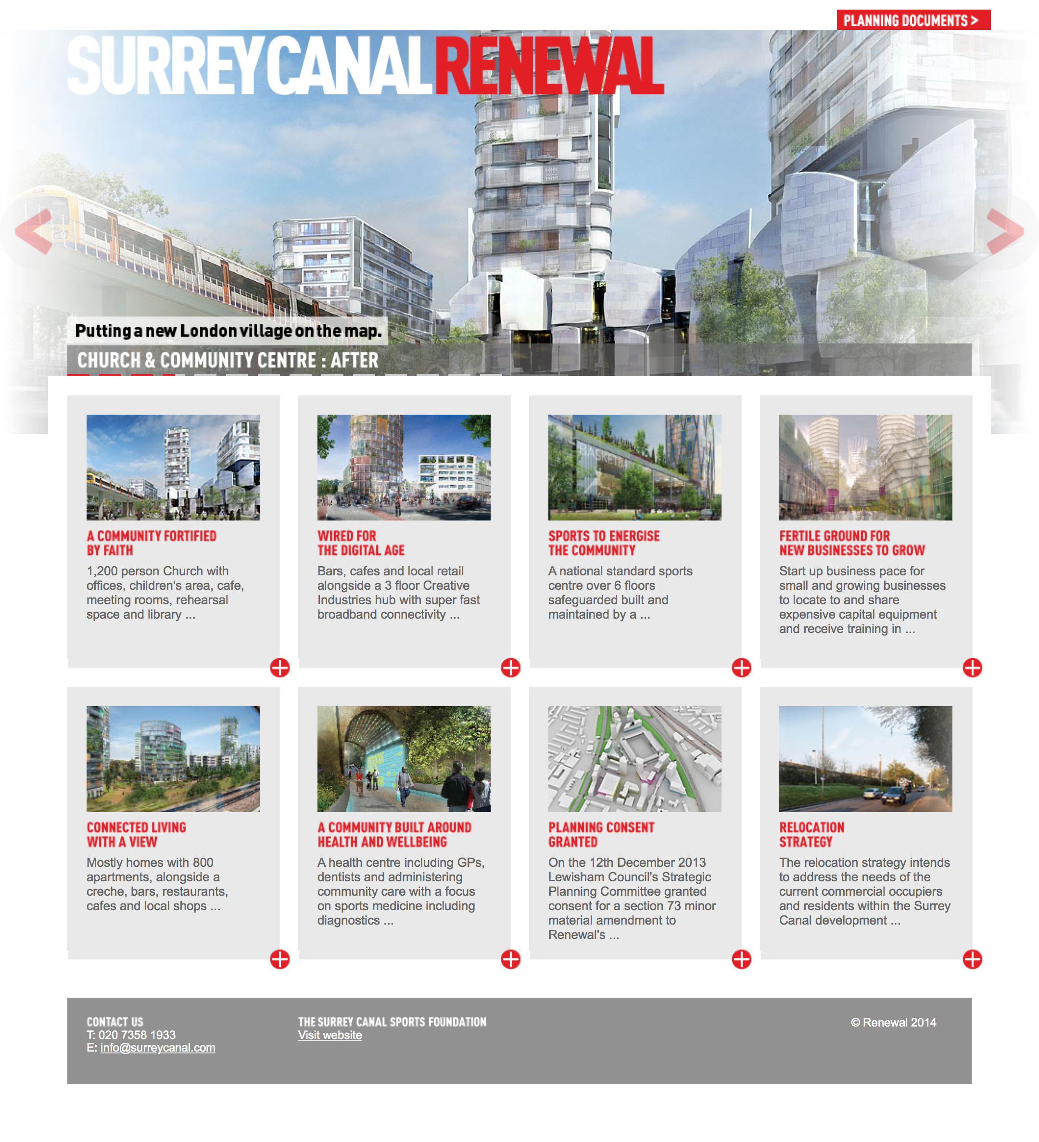
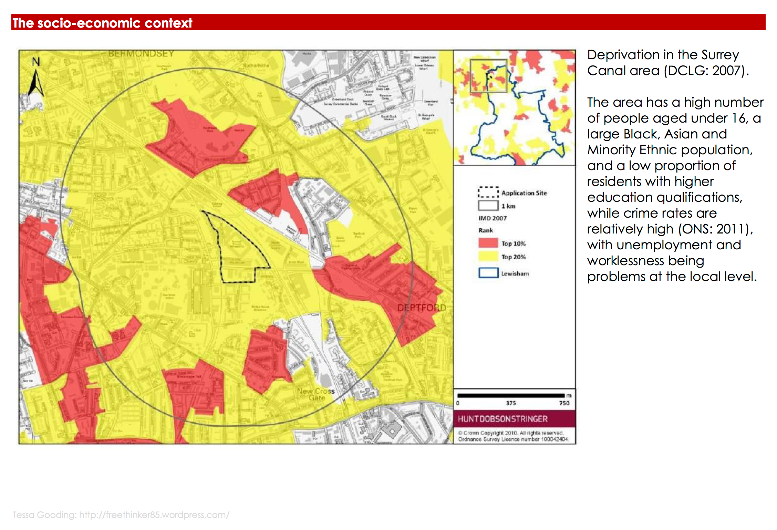
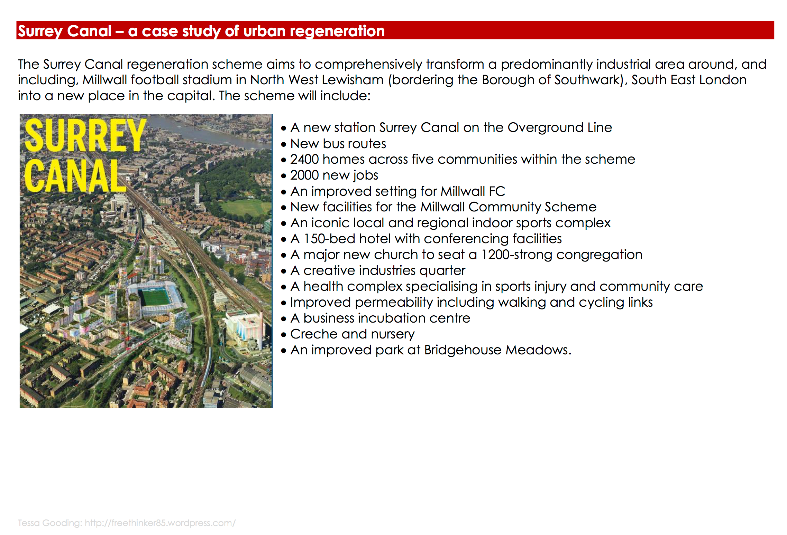
BERMONDSEY
DEPTFORD
NEW CROSS

Slide 5

faith in the city, faith in the community
following God’s call, to lead enable, and serve
love one another, relational
present & engaged, incarnational
God-breathed, inspired

Slide 6

Diocese of
Southwark
The Venerable
Alastair Cutting
Archdeacon
of Lewisham
& Greenwich

