Slide 1
Faith & Place Network
The Bradley proposition?
Dr R. David Muir
National Church Leaders Forum (NCLF)
University of Roehampton, Ministerial Theology

Slide 2


Slide 3
The Bradley proposition?
“Black Christianity may well prove to be a key agent in the re-evangelization of Christian Britain…”
(Ian Bradley, Believing in Britain: The Spiritual Identity of ‘Britishness’, London and New York, I.B. Tauris:2007,p. 198.)

Slide 4
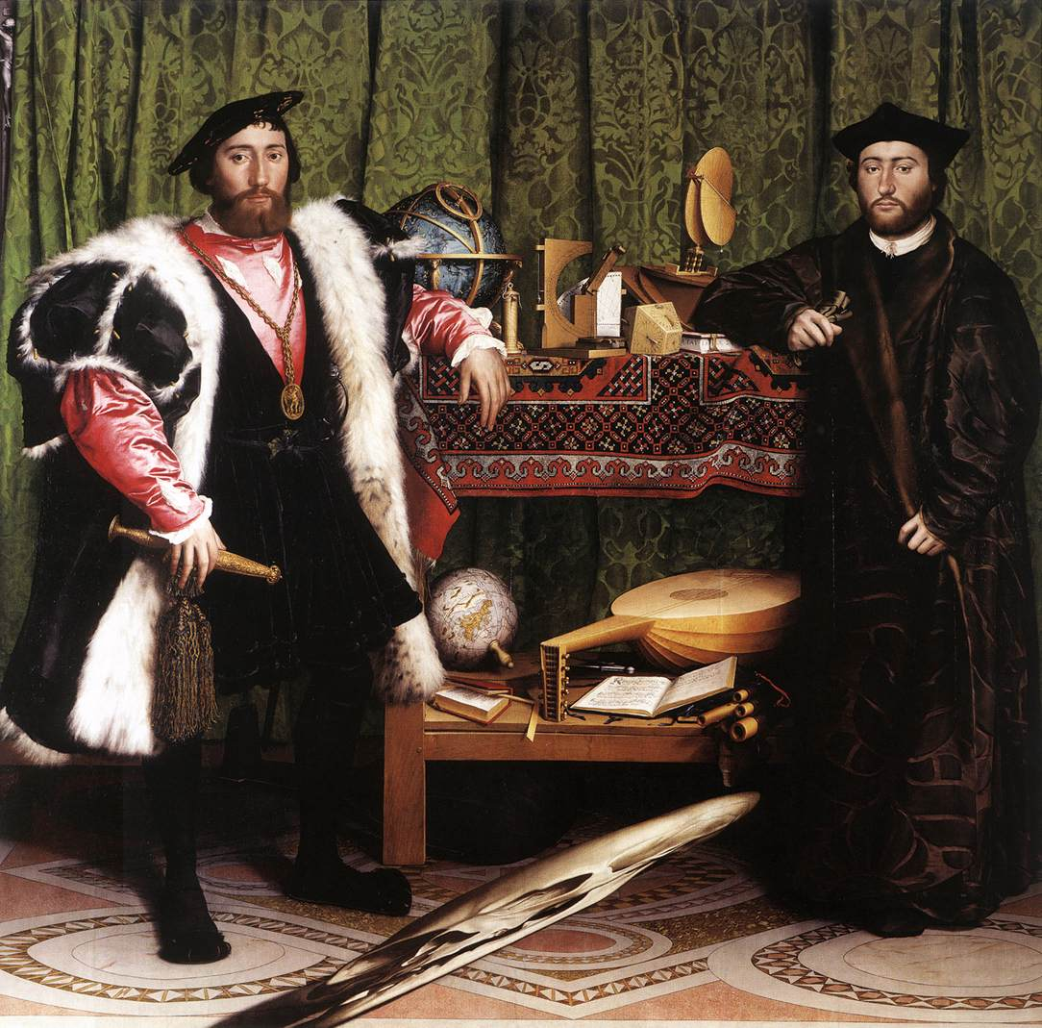
The ‘cultural problematic’: from the periphery to the centre? Hans Holbein (the Younger) “The Ambassadors” 1533

Slide 5
The proposition in action: beyond the N3
People
Premises
Programmes
Politics

Slide 6
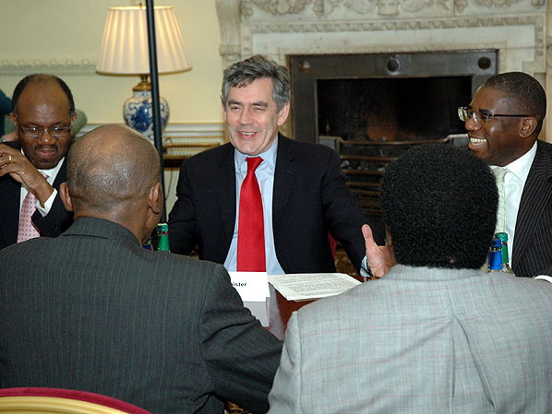
Let’s talk about planning permission….

